Slide 1
Data Center Infrastructure CT109-3-2&Version 2
Data Center Tiers and Standards

Slide 2
Topic & Structure of The Discussion
Uptime Institute for Data Center Tier ratings
TIA-942-A Telecommunications Infrastructure Standard for Data Centers

Slide 3
Learning Outcomes
At the end of this topic, YOU should be able to:
Understand Data Center Tiers and Standards

Slide 4
Key Terms You Must Be Able To Use
If you have mastered this topic, you should be able to use the following terms correctly in your assignments and exams:
Uptime Institute
TIA

Slide 5
Data Center Tiers
What are Data Centre tiers?
Data center tiers are a system used to describe specific kinds of data center infrastructure in a consistent way.
Uptime Institute(1995) Uptime Institute developed Tier ratings
Uptime Institute is the IT industry’s most trusted and adopted global standard for the proper design, build and operation of data centers – the backbone of the digital economy.

Slide 6
Data Center - Tier 1
This is the lowest tier in the Tier Standard. A data center in this tier is simple in that it has only one source of servers, network links, and other components.
Redundancy and backups in this tier are little or non-existent. That includes power and storage redundancies.
As such, specifications for a data center for this tier are not awe-inspiring. If a power outage were to occur, the system would go offline since there are no fail safes to kick in and save the day.

Slide 7
Data Center - Tier 1
The specifications of a tier one data center allow for uptime of approximately 99.671%.
The lack of backup mechanisms make this data center tier seem like a risk for many businesses but they can work for small internet based companies with no real-time customer support.
However, for companies with heavy reliance on their data, a tier one data center would not be practical.

Slide 8
Data Center - Tier 1
One of the advantages of tier one data centers is that they provide the cheapest service offering for companies on a budget.
However, a lack of redundancy means that the uptime of servers is considerably lower than tier two, three and four and maintenance on the facility will require shutting down of the entire facility thus more downtime.

Slide 9
Data Center - Tier II
This is the next level up after line one. Tier Two features more infrastructure and measures to ensure less susceptibility to unexpected downtime.
The requirements of a data center for this data center tier include all those of the first tier but with some redundancy.
For instance, they typically have one a single path for power and cooling. However, they also have a generator as a backup and a backup cooling system to keep the data center environment optimal.

Slide 10
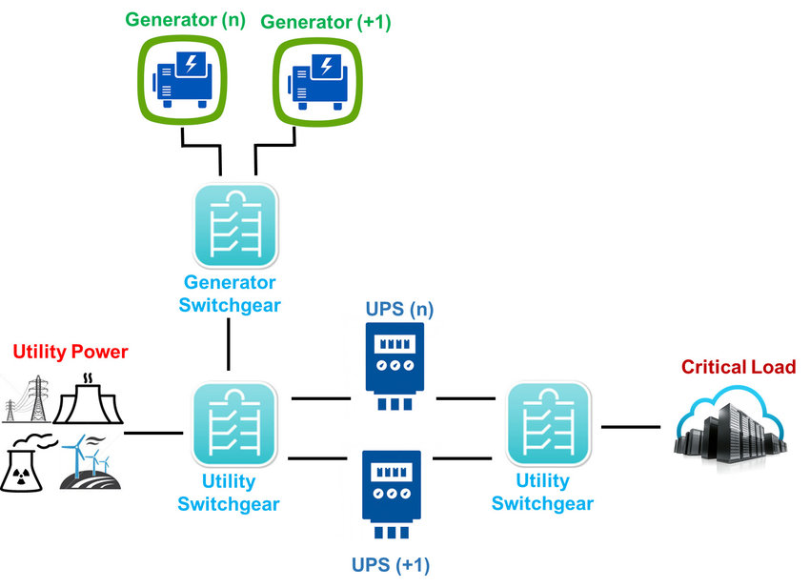
Data Center - Tier II
The specifications of a data center for the second tier allow for higher uptime compared to level one data centers that are approximately 99.741%.

Slide 11
Data Center - Tier III
Tier 3 allows for redundancy and backups in case of unexpected events that may cause downtime.
All server equipment has multiple power sources and cooling distribution paths.
In case of failure of any of the distribution paths, another takes over ensuring the system stays online.

Slide 12
Data Center - Tier III
Tier 3 data centers must have multiple uplinks and must be dual powered.
These specifications ensure you only have a maximum of two hours downtime annually, as a percentage 99.982%. Some of the equipment in tier three systems are fully fault-tolerant.
Some procedures are put in place to ensure maintenance can be done without any downtime. Tier three data centers are the most cost-effective solution for the majority of businesses.

Slide 13
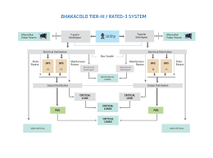
Data Center - Tier III

Slide 14
Data Center - Tier IV
Tier 4 is the highest level when it comes to data center tiers. It has an availability percentage of 99.99%.
A tier 4 data center is more sophisticated regarding its infrastructure as it has the full capacity, support, and procedures in place to ensure the maximum and optimum uptime levels.
Tier 4 data center fully meets all the specifications of the other three tiers.

Slide 15
Data Center - Tier IV
A tier 4 data center is error tolerant as it can operate normally even when there is an instance of infrastructural equipment failure.
A Tier 4 data center is fully redundant with multiple cooling systems, sources of power and generators to back it up.
It has an uptime level of 99.99% with an estimated downtime level of only 29 minutes annually.

Slide 16
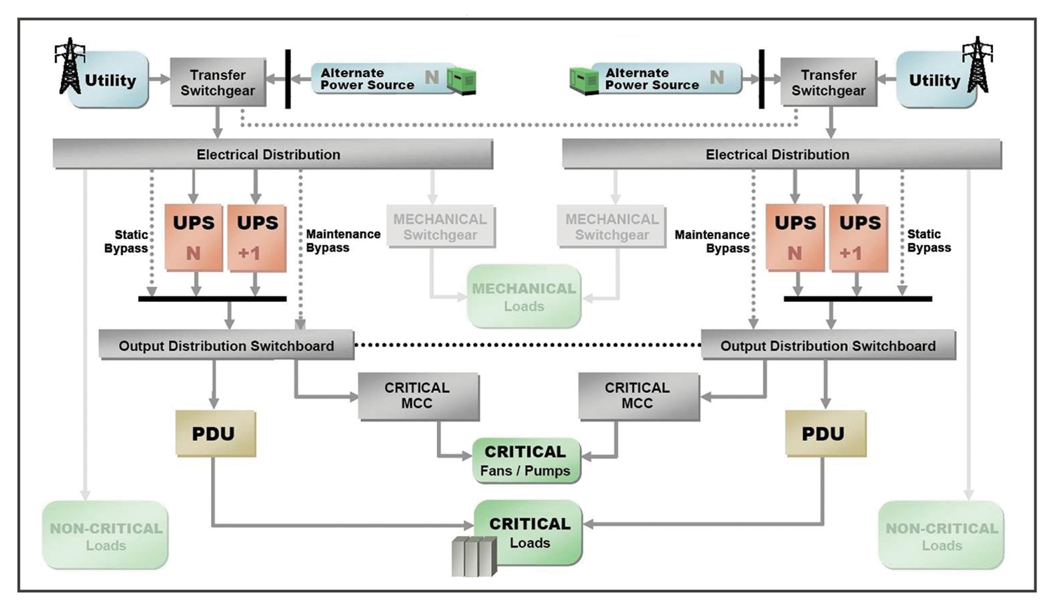
Data Center - Tier IV

Slide 17
Data Center Standards – TIA - 942
Guidelines for the design and installation of a data center
Multidisciplinary design considerations
There is no TIA tier rating system

Slide 18
Data Center Standards – TIA - 942
The basic data center spaces are the:
Entrance room
Main Distribution Area (MDA)
Horizontal Distribution Areas (HDAs)
Zone Distribution Area (ZDA), and
Equipment Distribution Area (EDA)

Slide 19
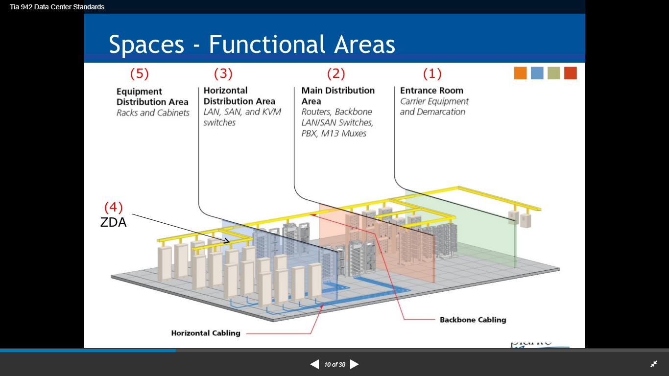
TIA – 942 – Data Center Spaces

Slide 20
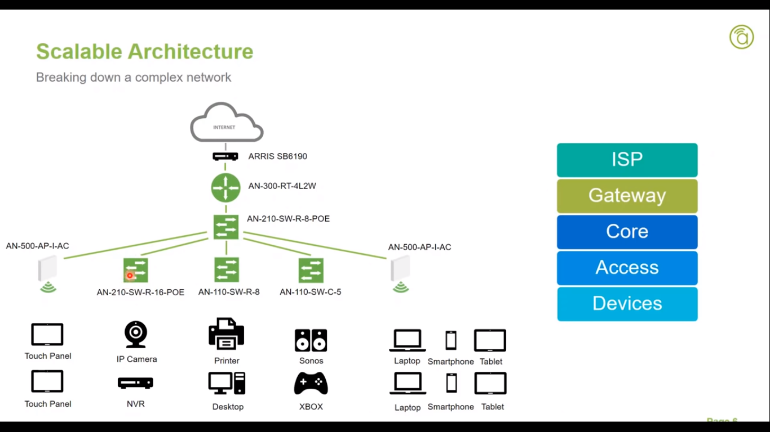
Network Architecture Vs Data Center Space

Slide 21
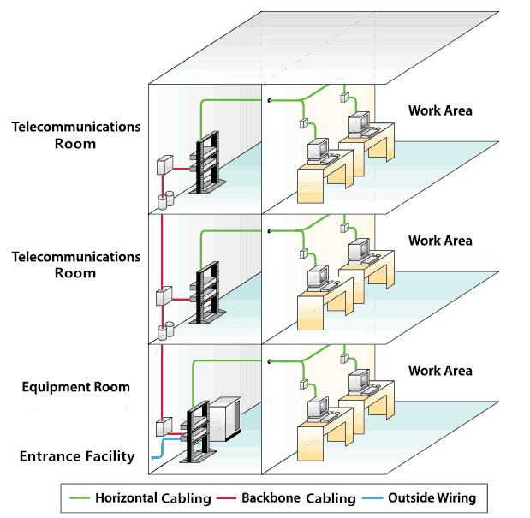
Backbone Vs Horizontal Cabling

Slide 22
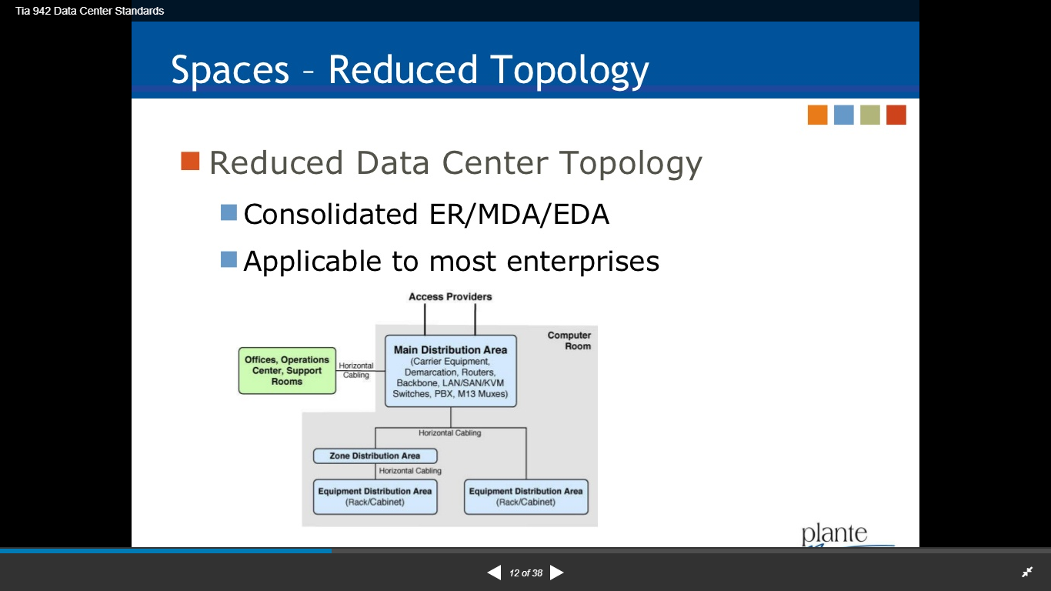
Virtual Server

Slide 23
Quick Review Question
1.Briefly explain the following:
i. Horizontal Cabling
ii. Backbone Cabling
2.Data Center Spaces are categorized into different Areas. What are they?
3.Discuss Data Center Tiers.

Slide 24
Summary of Main Teaching Points
Discussed Data Center Standards and IT Spaces according to the standard TIA 492

Slide 25
Question and Answer Session
Q & A

Slide 26
What we will cover next
Cooling System Options and Environmental Control

